Slide 1
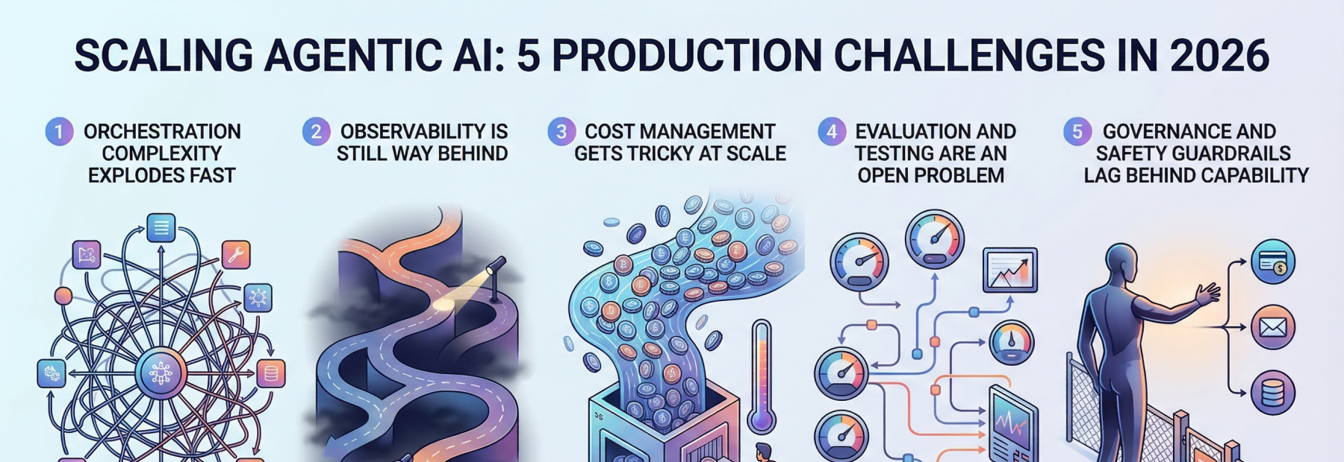
The Grand Capstone Challenge
Goal: Solve a high-stakes, real-world problem by building an end-to-end autonomous system.
The Paradigm Shift: Moving from "Experimental Code" to a Mission-Critical Product that is scalable, observable, and fully containerized.
The Framework: Leveraging LangGraph for the core orchestration, as it provides the state management required for complex medical or industrial pipelines.

Slide 2
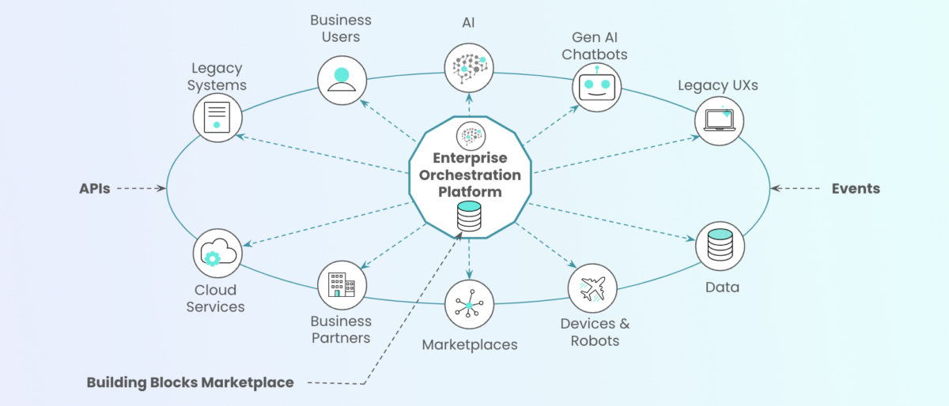
Technical Requirements (The "Agentic Orchestration")
3+ Specialized Agents: At least one Manager/Auditor agent to enforce quality and self-correction.
External Integration: Real-world "Hands" (e.g., searching live medical databases or controlling IoT sensors).
Production Layer: A FastAPI backend with asynchronous streaming and Pydantic validation.
DevOps Layer: A fully Dockerized deployment with multi-container orchestration.

Slide 3
Capstone Project Ideas
Autonomous Medical Research Pipeline: An agentic team that retrieves patient history via RAG, searches latest medical literature, and drafts a clinical summary.
Industrial IoT Failure Predictor: A system that monitors sensor data (Tools), analyzes patterns (Agents), and generates maintenance alerts through an API.
Wildcard – Automated Regulatory Compliance Agent: An agent that monitors local legal updates and automatically checks if a company's internal PDFs (Memory Vault) are still compliant.

Slide 4
Final Audit & System Defense
Code Review: A deep dive into your LangGraph state logic and error-handling protocols.
Architecture Defense: Justifying your choice of rerankers, tools, and orchestration patterns.
Observability Check: Proving the system is "traceable" and doesn't enter infinite loops in production.

